Slide 1
The Autoware Reference System
evan.flynn@apex.ai

Slide 2
What is a Reference System?
https://github.com/ros-realtime/reference-system

Slide 3
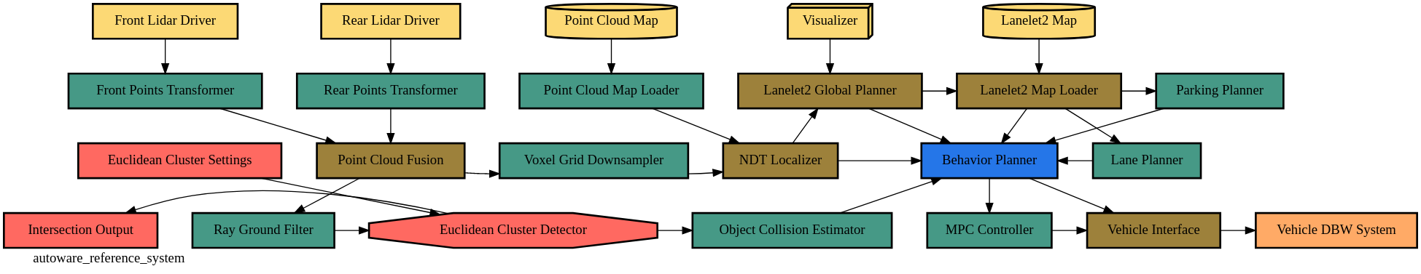
Reference System
Simulates a real-world scenario rather than only a theoretical one
Enables repeatable tests that can be confirmed by many parties
Measures some set of performance metrics in order to compare results
https://github.com/ros-realtime/reference-system

Slide 4
Reference System Base Node Types
Sensor Node
input node to system
one publisher, zero subscribers
publishes message cyclically at some fixed frequency
Transform Node
one subscriber, one publisher
starts processing for N milliseconds after a message is received
publishes message after processing is complete
Fusion Node
2 subscribers, one publisher
starts processing for N milliseconds after a message is received from all subscriptions
publishes message after processing is complete
Cyclic Node
N subscribers, one publisher
cyclically processes all received messages since the last cycle for N milliseconds
publishes message after processing is complete
Command Node
prints output stats everytime a message is received
Intersection Node
behaves like N transform nodes
N subscribers, N publisher bundled together in one-to-one connections
starts processing on connection where sample was received
publishes message after processing is complete
https://github.com/ros-realtime/reference-system

Slide 5
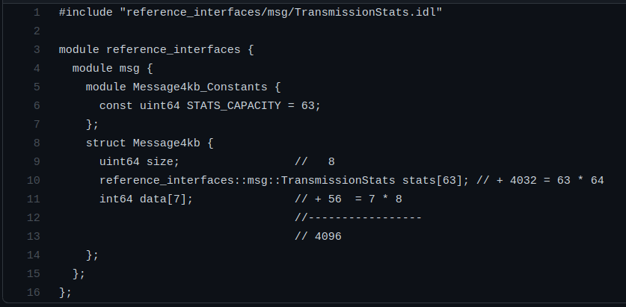
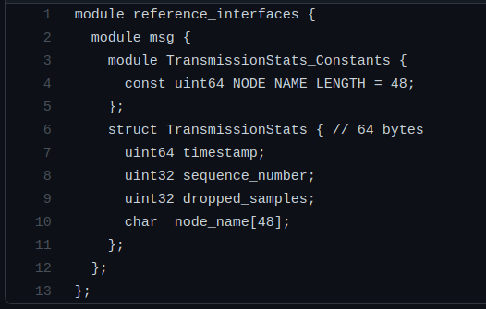
Reference Interfaces
One single message type is used for the entire system during each experiment run
This message type can be swapped depending on what is being measured
So far only one message type has been defined, but many more are waiting to be added
We store these message types in a package called Reference Interfaces
reference_interfaces/msg/Message4kb.idl
reference_interfaces/msg/TransmissionStats.idl
https://github.com/ros-realtime/reference-system

Slide 6
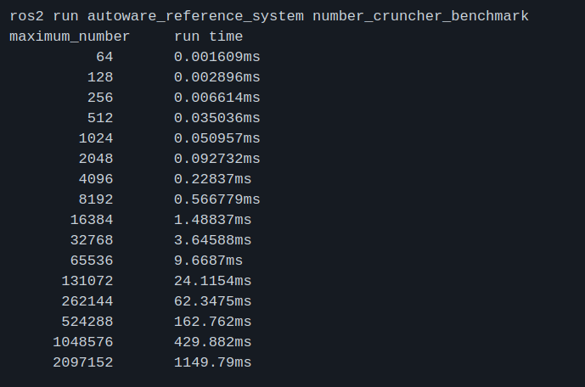
Simulated (Pseudo) Work
Pseudo work is done by each node in the system in order to stress the system as in the real world
This pseudo work is done by finding prime numbers
Starting from 3 since 0, 1 and 2 are not prime numbers
Going up to some maximum value
Getting to this maximum value takes different amounts of time depending on the platform
To assist with this, a number_cruncher_benchmark program is provided
outputs the time it takes your system to find all the prime numbers up to a maximum value
This maximum number sets how long each node will process for (aka “number crunch”)
Default maximum_number
https://github.com/ros-realtime/reference-system

Slide 7
The Autoware Reference System
https://github.com/ros-realtime/reference-system

Slide 8
The Autoware Reference System
Simulates the real-world structure of the Autoware.Auto Project
Uses all base node types
Sensor, Transformer, Fusion, Cyclic, Command and Intersection
Has a signal path just like the real world that can be reliably tested
Front Lidar Driver -> Object Collision Estimator
https://github.com/ros-realtime/reference-system

Slide 9
What can be measured?
https://github.com/ros-realtime/reference-system

Slide 10
Key Performance Indicators (KPIs)
Latency of Front Lidar Driver/Rear Lidar Driver to the Object Collision Estimator
Every lidar sample should cause the Object Collision Estimator to update
Lower latency of the signal chain is better
Jitter of the timer for the Behavior Planner Cyclic Node
Timer is supposed to trigger ever 100ms, but sometimes goes fast or slow depending on many things
We can measure this jitter and report it
Lower jitter and drift is better
Count the number of Dropped Samples
Always use the latest samples - throw away old ones
Lower number of dropped samples is better
CPU Utilization
In general a lower CPU utilization is better since it enables you to choose a smaller CPU or implement more functionality
Lower CPU utilization is better
Memory Utilization
In general a lower memory utilization is better since it enables you to choose a smaller memory or have more space for other things
Lower memory utilization is better
https://github.com/ros-realtime/reference-system

Slide 11
Thank you!
evan.flynn@apex.ai
https://github.com/ros-realtime/reference-system

